Slide 1



MARKETING AND RETAIL ANALYTICS
CAPSTONE PROJECT
Pankaj Kumar
Shoeb Memon
Jayalekshmi K

Slide 2


AGENDA
Objective
Background
Data Visualization
Insights
Recommendations
Appendix

Slide 3

OBJECTIVE
In this project, we need to identify top products that contribute to the revenue using Pareto analysis
Market basket analysis to analyse the purchase behaviour of individual customers
Explore what items are more likely to be purchased individually or in combination with some other products.

Slide 4


BACKGROUND
OList is an e-commerce company that has faced some losses recently and they want to manage their inventory remarkably in order to reduce unnecessary costs that they are bearing.
To meet the demands of the customers, company need to store tons and tons of products in warehouses. Some warehoused products might be fast-moving products and some might be slow-moving.
Each products being stored incurs a cost to the company in terms of space and maintenance, it is necessary for the organization to plan their inventory well.

Slide 5
DATA VISUALIZATION

Slide 6

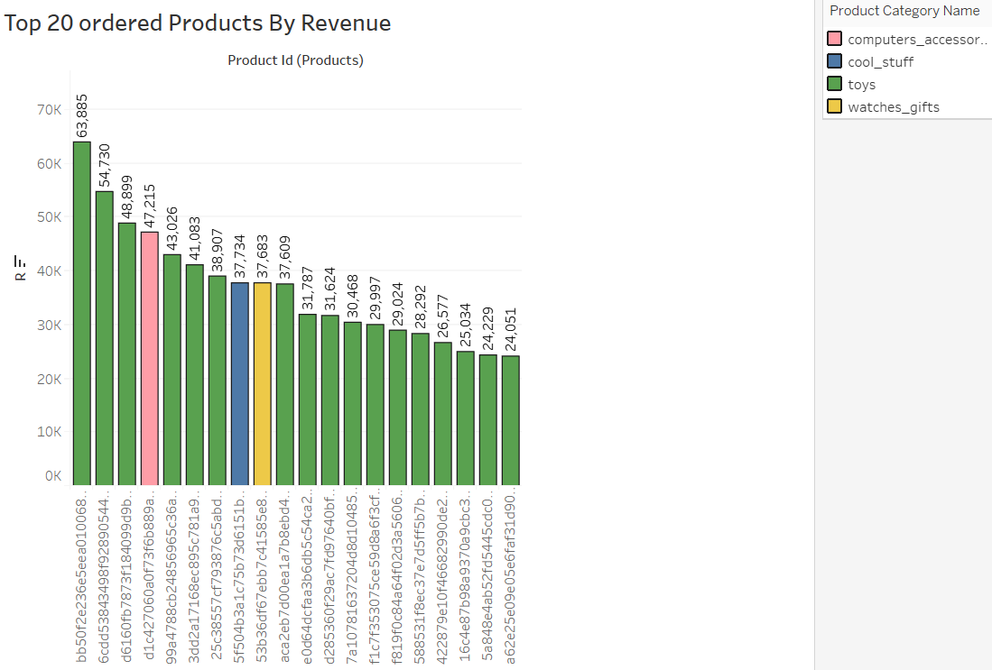
TOP 20 ORDERED PRODUCTS BY REVENUE
The highest revenue contributed to OList company was "toys" category.
The category "toys" constitute 20% of the products which generates 80% of the revenue.

Slide 7
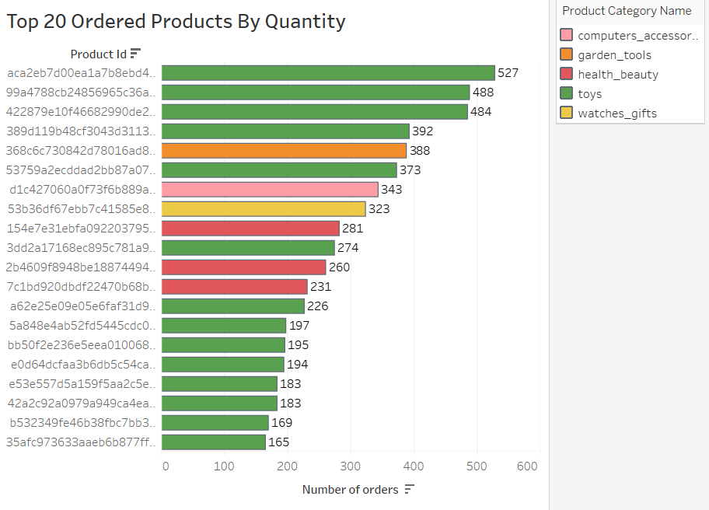

TOP 20 ORDERED PRODUCTS BY QUANTITY
The highest ordered product is from the "toys" category and it is been ordered 527 times.
In the Top 20 products, that are frequently ordered belong to the "toys" category.

Slide 8
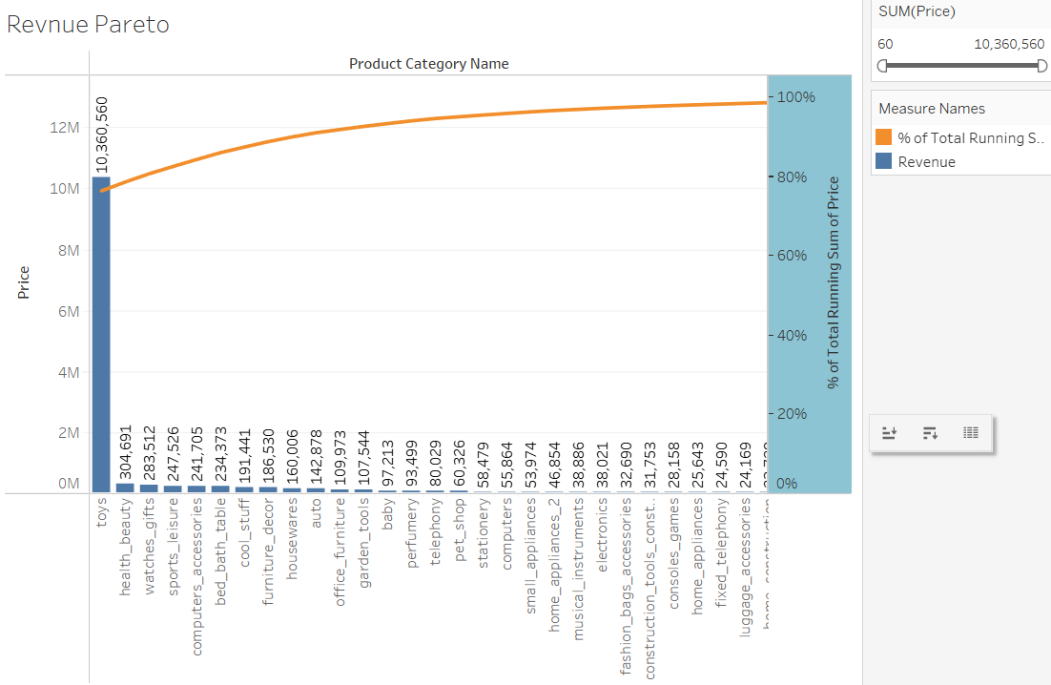
REVENUE PARETO
* "toys","health_beauty"and "watches_gift" combine generate more than 90% of the total revenue.
* "toys" alone generates more than 80% of the revenue.
* Remaining product categories nearly generates 10% of the revenue.

Slide 9
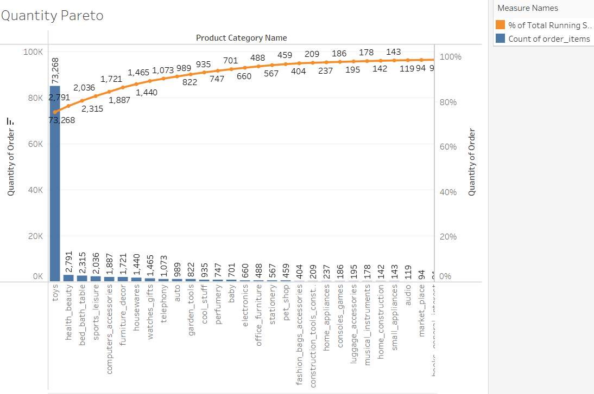
QUANTITY PARETO
* "toys", “health_beauty” and “bed_bath_table” make up to 80% of the total orders.
* “toys” alone has 75% of the total orders.
* The rest of the product categories generate 20% of the total orders

Slide 10
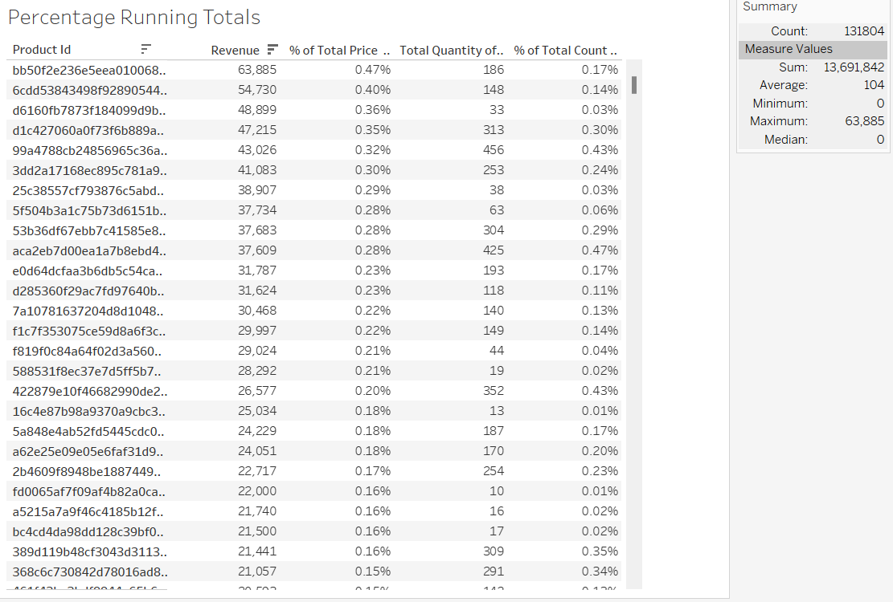
PERCENT RUNNING TOTALS
* The Percentage of Total Running Revenue and Quantity Ordered has been broken down by Product Id.
* The contribution of each product towards the total revenue can be found.

Slide 11
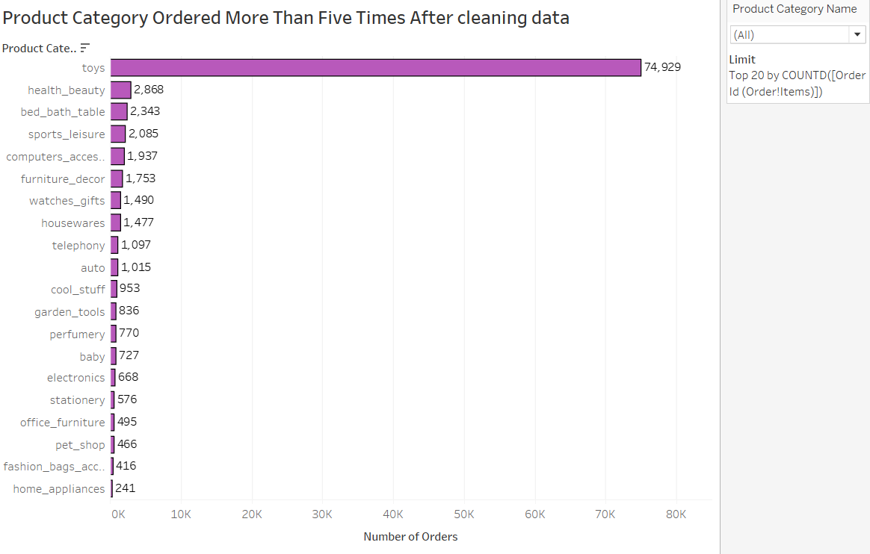


PRODUCT ORDERED MORE THAN 5 TIMES
"toys" category is the most ordered category with a total of 74,929 orders.
"health_beauty", "bed_bath_table" and "sports_leisure" are the following most ordered category.

Slide 12
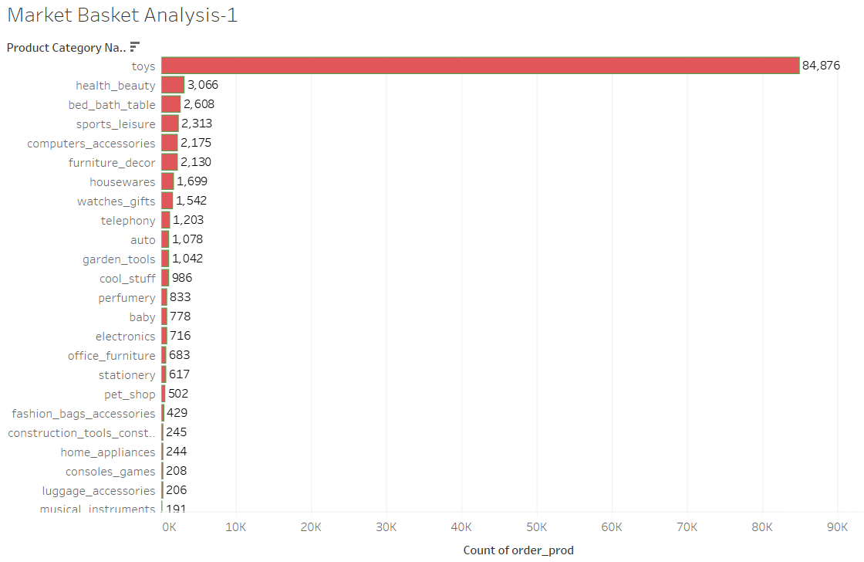
MARKET BASKET ANALYSIS-1
Market Basket Analysis is performed to identify combinations of product categories that are ordered frequently
"Toys" are the most ordered category followed by health beauty,bed_bath_table,sport leisure, computer_accessories and funiture_decor .

Slide 13
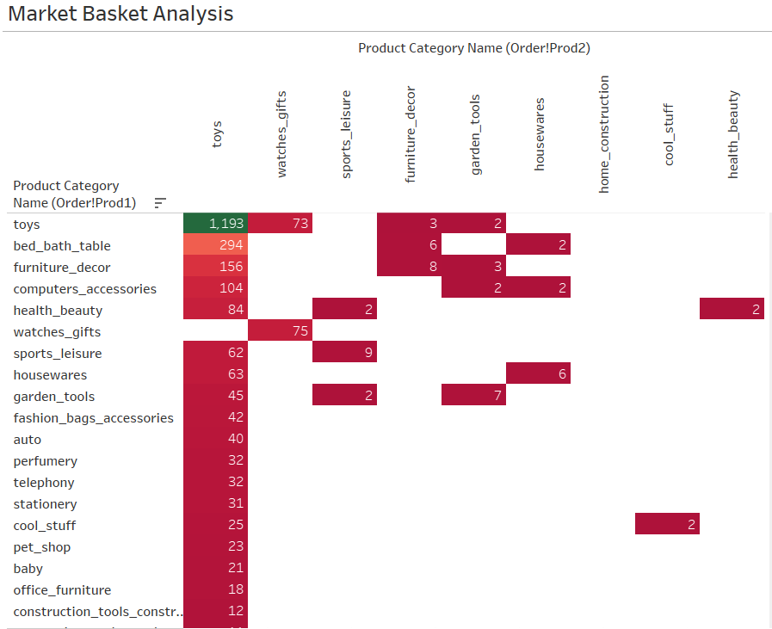
MARKET BASKET ANALYSIS-2
"Toys" are always the product category that is ordered the most.
This is followed by a combination of bed_bath_table and furniture_decor.

Slide 14
INSIGHTS
*The product category "toys" which is 20% of the total products, it generates 80% of the total revenue.
*Product categories such as health_beauty, bed_bath_table, sports_leisure, computers_accessories, and furniture_decor are the most frequently ordered after the category "toys".
*The above mentioned products categories with Toys or/and with each other are most frequently purchased .
* Even though some of the items are highly priced, these are still frequently ordered/purchased by customers.

Slide 15
RECOMMENDATIONS
OList e-commerce company should focus on customers who are buying "toys" to boost the sales as it is the most ordered product category thereby decreasing the warehouse maintenance cost.
This e-commerce company should be also focusing on products which generates more than 80% of the total revenue.This can be done by restocking those products frequently in adequate amount .
Reduce stocking products which are less in demand/revenue generation.
Offer discounts on the frequently ordered category associations and also combo-offers to encourage cross selling among the products.

Slide 16

Thank You

